Slide 1









Sample 1
LENDING CLUB CASE STUDY
LendingClub is a financial services company, which specializes in lending various types of loans to urban customers. While approving a loan application, the company wants to assess the likelihood of a customer to repay the loan vs defaulting on it essentially establishing the creditworthiness. While make such a decision, the company wants a balance between potential loss of business if a ‘good’ customer is denied a loan, vs extending the same to a ‘bad’ customer leading to a financial loss.
Exploratory Data Analysis (EDA) was performed on the dataset in a multi-stage process. The dataset contains loan details for all loans issued through years 2007 to 2011.
This presentation describes the key findings from the EDA and makes recommendations for improving the business outcomes.
Submission By:
Ramprasad Gutulla
Vidyadhar Watve
- Dec2024
Understand Business Objective
Understand Data
Perform Data Cleanup
Perform Univariate
Analysis
Bi-Variate and
Multi-Variate Analysis
Summary of findings
Recommend a solution to the business problem

Slide 2
Key observations about the Data
The dataset contains 39717 rows and 111 columns
COLUMN analysis
54 columns are found to be blank or NULL values
09 columns are found to have a single value and are not useful for analysis
04 columns appear to have some valid values, but majority (>50%) are NULL
10 columns carry data of no significance for the analysis e.g. ID, Title, URL
09 columns carry information after a loan is granted, so has no bearing on establishing creditworthiness
03 columns have fewer missing values and need to be imputed or dropped (emp_length, revol_util, pub_rec_bankrupt)
ROWS analysis
0 duplicate rows were found
1140 rows belong to ‘current’ or active loans. These do not contribute to historical data
Improper data
03 columns need conversion of data type (E.g. interest rate to numeric, dates to be of type datetime.)
Conclusion: Data cleanup is necessary to drop invalid and unwanted data and to convert it to a consumable format.

Slide 3
Summary of cleanup performed on the data
Original Dataset: 39717 rows and 111 columns
Cleaned up Dataset: 38557 rows and 27 columns
Dropping of invalid and unusable column data reduced the columns to 111-54-13-19 = 25
54 columns with all NULL values are dropped
13 columns with majority NULL values or single value are dropped
19 columns with no significance to creditworthiness and statistically insignificant are dropped
Standardizing Data (Column datatype changed, 2 columns added)
Column carrying date information converted from Object to Datetime for easier analysis
Further the Datetime was split into additional 2 columns for Month and Year
Dropping rows that are not useful for analysis
1140 rows corresponding to active loans were dropped as there is no default
Outlier Treatment
20 Rows with outliers (above 95th quartile) were dropped so that they do not skew the analysis

Slide 4
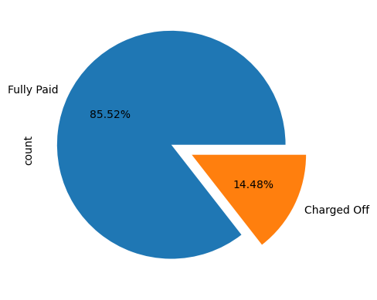
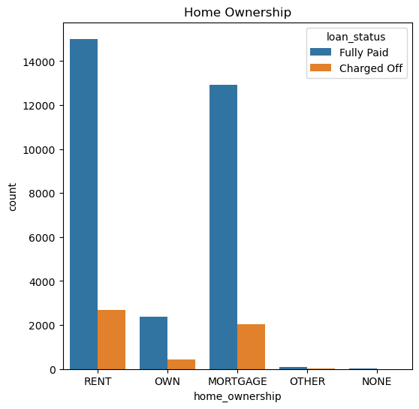
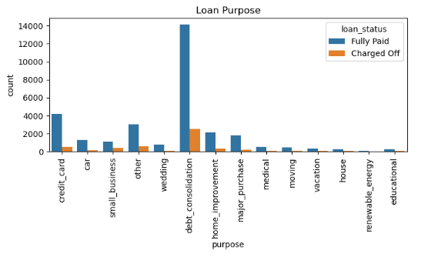
Univariate Analysis Performed on Unordered Categorical Variables, Ordered Categorical Variables, Quantitative Variables
Inferences:
14.5% of overall loans get charged-off which is very concerning
Majority of Loans are taken for debt consolidation
Majority of loans are taken who doesn't own a home
Loans issued are decremental from grades A-G
Loans issued are decremental from experience 0 to 9 but 10+ has a spike probably because all other experiences fall under this category. Going by this trend we can assume more the experience less the possibility of taking loan
Loans issued are almost doubled every year
Majority of Loans applicants has annual income between 30k and 80k
Majority of Loans issued are for value less than 15k
Interest rate of majority of loans is between 7.5 to 15

Slide 5
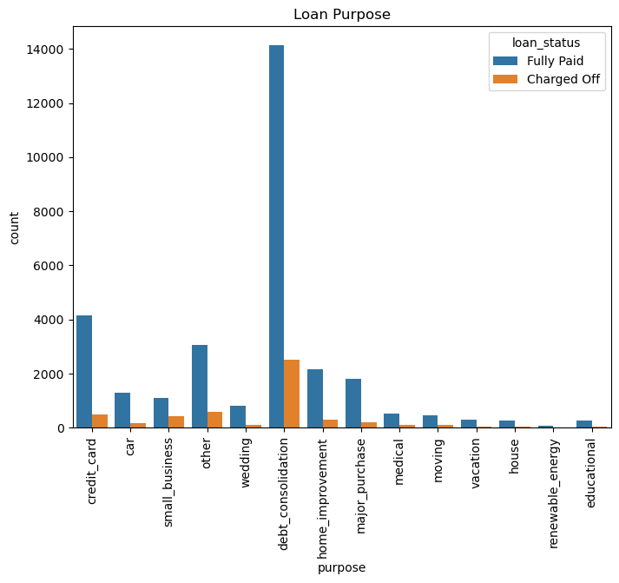
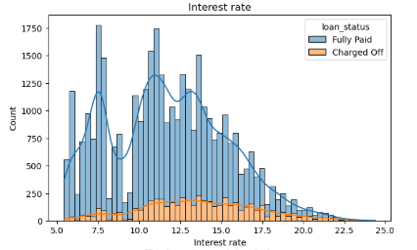
Univariate Analysis Performed on Unordered Categorical Variables, Ordered Categorical Variables, Quantitative Variables
Inferences:
14.5% of overall loans get charged-off which is very concerning
Majority of Loans are taken for debt consolidation
Loans issued are decremental from grades A-G
Loans issued are decremental from experience 0 to 9 but 10+ has a spike probably because all other experiences fall under this category. Going by this trend we can assume more the experience less the possibility of taking loan
Majority of loans are taken who doesn't own a home
Loans issued are almost doubled every year
Majority of Loans applicants has annual income between 30k and 80k
Majority of Loans issued are for value less than 15k
Interest rate of majority of loans is between 7.5 to 15

Slide 6
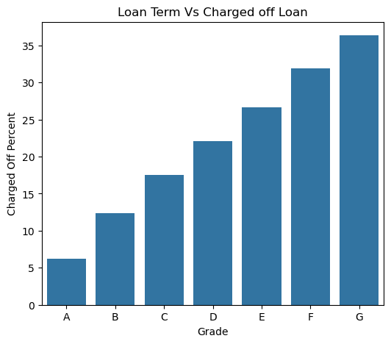
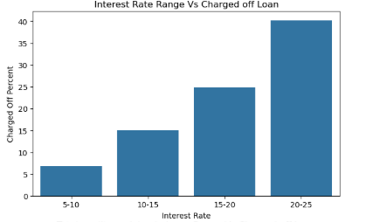
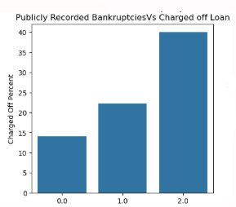
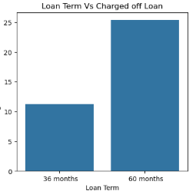
Bi-Variate Analysis
Inferences:
Lower the annual income the percentage of charged off loan are higher
Higher the loan amount/interest rate/Revolving line utilization the percentage of charged off loan are higher
Dti and Total credit revolving balance doesn't seem to be a considerable factor in loan defaulting
More the number of inquiries in last 6month, derogatory public records , and public recorded Bankruptcies the percentage of charged off loans are higher
Loans taken for small business more percentage of charged off loans
Higher the grades, subgrades, loan term higher the percentage of charged off loans
Home ownership other has more percentage of charged off loans
Loan term with 60 months have a greater number of charged off loans
State/Employment length/number of open accounts doesn't seem be a considerable factor in loan defaulting

Slide 7
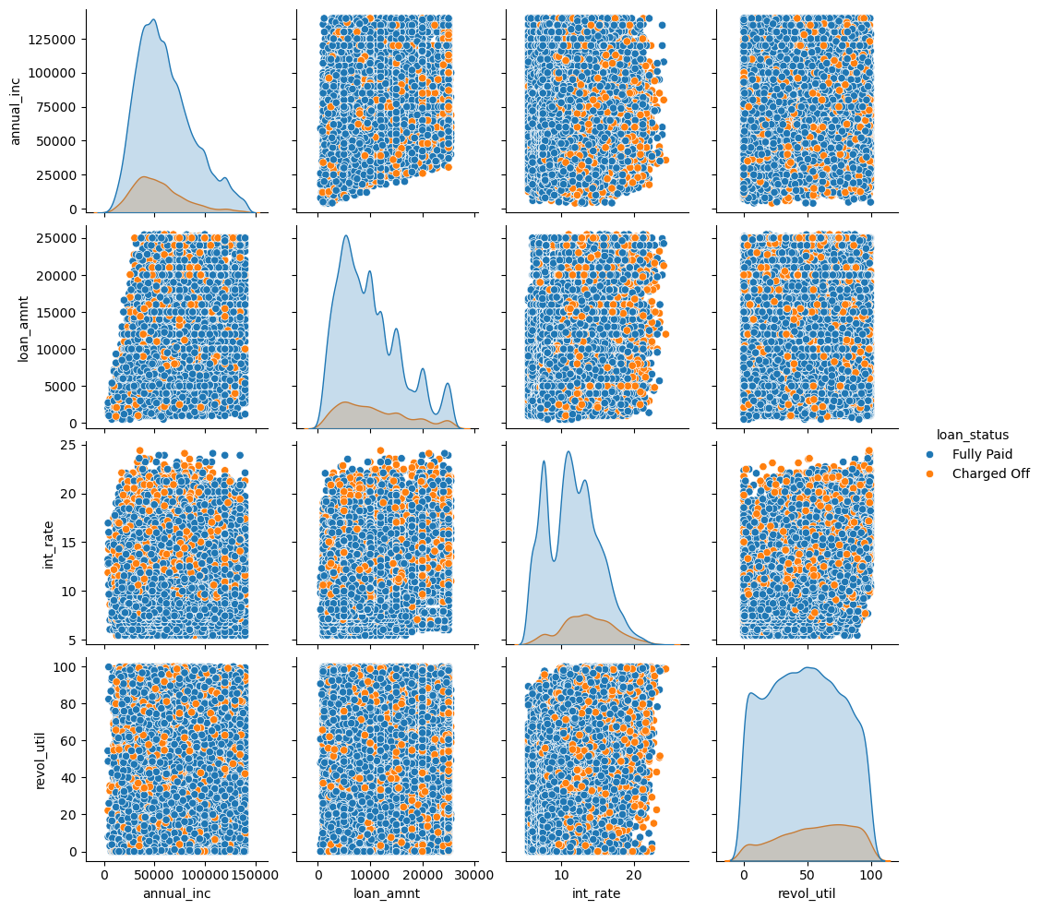
Multi-Variate Analysis
Inferences:
More the interest rate more the chances of
Defaulting irrespective of annual income,
loan amount, credit line utilization

Slide 8
Conclusion
Strong indicators of default
Any loan with interest rate above 18% has more chances of defaulting
Applicants with grades F,G has more chances of defaulting
Applicants with loan purpose small business and interest rate greater than 15% has more chances of defaulting
Applicants with Annual income <= 90k and Interest >= 17% has more chances of defaulting
Applicants with public recorded bankruptcies has more chances of defaulting
Weak indicators Or In-conclusive indicators of Default
Seasonality: There is some seasonality with number of loan applications increasing during May-June & Dec, likely due to holidays and festivals. This is not a as prominent though.
Experience : Applicants with 10+y of experience are seen to have higher count of defaults. This is counter-intuitive
Given with higher experience and age it is expected that the person has reached more stability and likely having decent
Earnings. Hence experience alone does not help to establish creditworthiness.

Slide 9
Recommendation
Loan term length: Applicants applying for longer term loans ( 60 months) have a more rate of default and hence should be scrutinized more with respect to their background and prior default.
Reason of loan: Debt consolidation appears to be a prominent factor associated with the default. There are likely elements of mis-use and fraud and hence the company should minimize extending loans for such purpose.
Verification of applications: Defaults are seen equally among verified and un-verified applications. The company should do a strong review and introspection on its customer verification process and introduce more compliance audits.
Income level: Lower income group has been observed to have more defaults. The company could set a lower limit on this band to ensure it does not exceed the repaying capability.
Mortgage: Limit loan exposure to this segment given high chance of default

Slide 10
Thank you

Slide 11
This slide to be removed from the
final submission
Hypothesis to verify:
PLOT
# Number of loans which were approved every year/month
HYPOTHESIS
# count of loan application is increasing every passing year and default as well?
# Dip in loans in 2008 ? Factor recessions?
PLOT
# Loan paying term
HYPOTHESIS
# Loan period 60 months had more charge-offs compared to applicants who had taken loan for 36 months.
Loans are granted on the basis of the borrower’s credit score, credit history, desired loan amount, debt-to-income ratio
and assigned a credit grade that determined the payable interest rate and fees.
<< Can you check if data supports this statement>>
The standard loan period is three years, five-year period attracts higher interest rate as per bank policy.

